Slide 1
+
QuickDoc
ER Diagrams
Team 4 • CS691 • Pace University • Sprint 3
Conceptual ERD | Logical ERD | Sprint 3 Scope

Slide 2
Team 4 : QuickDoc
Conceptual ERD — List of Entities
Entity Name | Description | Primary Attributes
User | Represents a registered system user | userId (PK), email, passwordHash, roleId, isActive
Patient | Represents a registered patient user | patientId (PK), userId, firstName, lastName, dateOfBirth
Doctor | Represents a registered healthcare provider | doctorId (PK), userId, specialtyId, licenseNumber, consultationFee
Specialty | Medical specialty assigned to a doctor | specialtyId (PK), name, description
Appointment | A booking between a patient and a doctor | appointmentId (PK), patientId, doctorId, slotId, apptDatetime
AppointmentSlot | Available time slot generated from schedule | slotId (PK), doctorId, scheduleId, slotDate, startTime
Review | A patient's review and rating for a doctor | reviewId (PK), patientId, doctorId, rating, body
Favorite | A patient's saved/favorite doctor | favoriteId (PK), patientId, doctorId, createdAt
Schedule | A doctor's available time slots for booking | scheduleId (PK), doctorId, dayOfWeek, startTime, endTime
UserRole | Defines system roles (Patient, Doctor, Admin) | roleId (PK), roleName
AppointmentStatus | Tracks appointment lifecycle states | statusId (PK), statusName

Slide 3
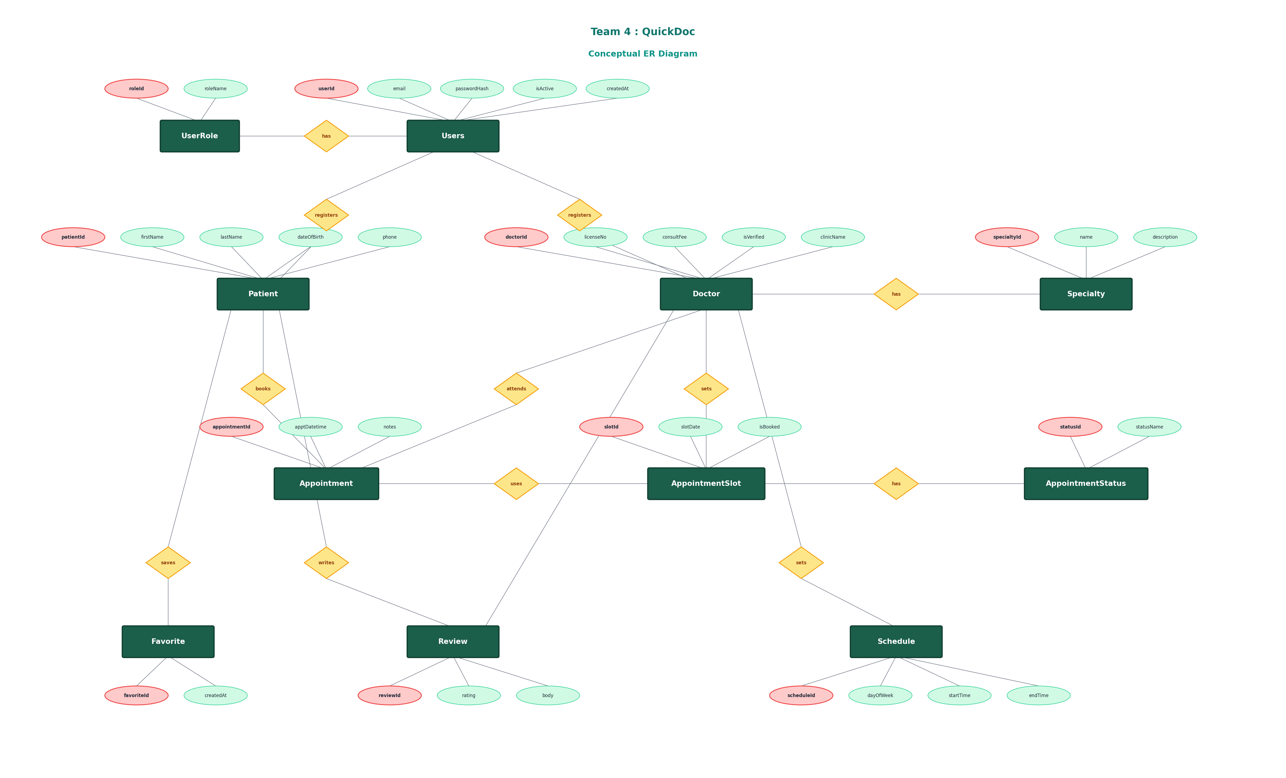
Team 4 : QuickDoc
Conceptual ER Diagram

Slide 4
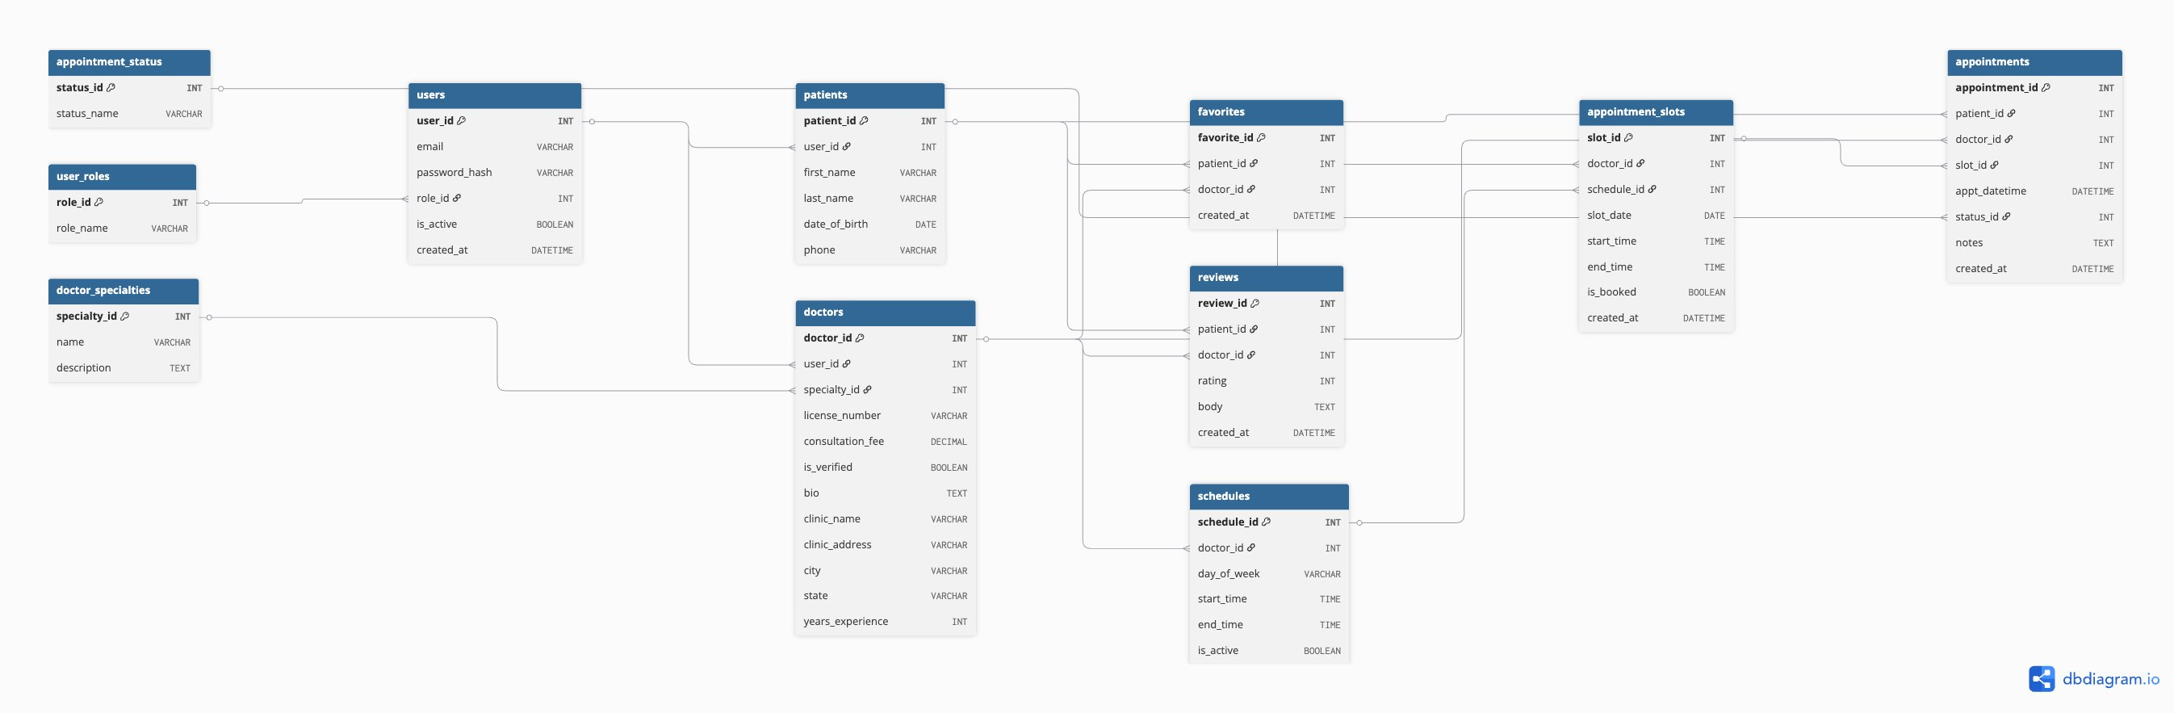
Team 4 : QuickDoc
Logical ER Diagram — Sprint 3 Scope
Reference Tables

